Slide 1
CHAPTER THREE
Inter-thread and inter-process communications using shared memory, pipes and sockets

Slide 2
Inter-thread Communication
Inter-thread communication in Java is a technique through which multiple threads communicate with each other.
It provides an efficient way through which more than one thread communicate with each other by reducing CPU idle time. CPU idle time is a process in which CPU cycles are not wasted.
When more than one threads are executing simultaneously, sometimes they need to communicate with each other by exchanging information with each other.
A thread exchanges information before or after it changes its state.

Slide 3
cont’d
If Thread B waits for Thread A to produce data, it will waste many CPU cycles.
But if threads A and B communicate with each other when they have completed their tasks, they do not have to wait and check each other’s status every time.
Thus, CPU cycles will not waste. This type of information exchanging between threads is called inter-thread communication in Java.
Inter thread communication in Java can be achieved by using three methods provided by Object class of java.lang package. They are:
wait()
notify()
notifyAll()

Slide 4
Cont’d
Inter-thread communication methods can be called only from within a synchronized method or synchronized block of code.
otherwise, exception named IllegalMonitorStateException is thrown.
Since it throws a checked exception, therefore, you must be used these methods within Java try-catch block.
wait() Method
It notifies the current thread to give up the monitor (lock) and to go into sleep state until another thread wakes it up by calling notify() method.
All overloaded forms of wait() method throw Interrupted Exception.
If time is specified in the wait() method, a thread can wait for maximum time.

Slide 5
Cont’d
Note:
A monitor is an object which acts as a lock. It is applied to a thread only when it is inside a synchronized method.
Only one thread can use monitor at a time. When a thread acquires a lock, it enters the monitor.
When a thread enters into the monitor, other threads will wait until first thread exits monitor.
notify() Method
The notify() method wakes up a single thread that called wait() method on the same object.
If more than one thread is waiting, this method will awake one of them.

Slide 6
Cont’d
notifyAll()
The notifyAll() method is used to wake up all threads that called wait() method on the same object.
The thread having the highest priority will run first.
Why wait(), notify() and notifyAll() methods are defined inside Object class, not Thread class?
This is because all these three methods are related to lock and Java provides lock at Object level, not at the Thread level.
Therefore, they are defined in Object class.

Slide 7
public class A {
int i;
boolean flag = false; // flag will be true when data production is over.
synchronized void deliver(int i){
if(flag)
try {
wait(); // Wait till a notification is received from Thread2. There will be no wastage of time. }
catch(InterruptedException ie){
System.out.println(ie); }
this.i = i;
flag = true; // When data production is over, it will store true into flag.
System.out.println("Data Delivered: " +i);
notify(); // When data production is over, it will notify Thread2 to use it. }
synchronized int receive(){
if(!flag)
try {
wait(); // Wait till a notification is received from Thread1.}
catch(InterruptedException ie){
System.out.println(ie); }
System.out.println("Data Received: " + I);
flag = false; // It will store false into flag when data is received.
notify(); // When data received is over, it will notify Thread1 to produce next data.
return i;}}

Slide 8
public class Thread1 extends Thread{
A obj;
Thread1(A obj){
this.obj = obj;
}
public void run(){
for(int j = 1; j <= 5; j++){
obj.deliver(j);
}}}
public class Thread2 extends Thread {
A obj;
Thread2(A obj){
this.obj = obj;
}
public void run(){
for(int k = 0; k <= 5; k++){
obj.receive();}}}

Slide 9

public class Communication
{
public static void main(String[] args)
{
A obj = new A(); // Creating an object of class A.
// Creating two thread objects and pass reference variable obj as parameter to Thread1 and Thread2.
Thread1 t1 = new Thread1(obj);
Thread2 t2 = new Thread2(obj);
// Run both threads.
t1.start();
t2.start();
}
}

Slide 10
Cont’d
Difference between wait() and sleep() in Java
Object.wait() and Thread.sleep() are entirely two different methods in Java that are used in two different contexts. Here, we have listed a few differences between these two methods.
wait() method is always called from synchronized block otherwise, it will throw IllegalMonitorStateException whereas sleep() method can be called from any code block.
wait() method releases the acquired lock while sleep() method does not release the lock.
wait() is called on Object whereas sleep() is called on Thread.
waiting thread can be awakened by invoking notify()/notifyAll() methods while sleeping thread cannot be awakened.

Slide 11
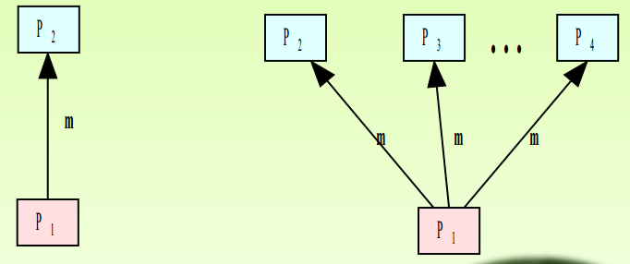
Inter-process communication
What is IPC?
Process: Running program is called a process.
IPC: Exchange of data between two or more separate, independent processes Operating systems provide facilities for inter-process communication (IPC).
L
Uni-cast Multi-cast

Slide 12
cont’d
Processes within a system may be independent or cooperating
Cooperating process can affect or be affected by other processes, including sharing data
Reasons for cooperating processes:
Information sharing
Computation speedup
Modularity
Convenience
Two models of IPC
Shared memory
Message passing

Slide 13
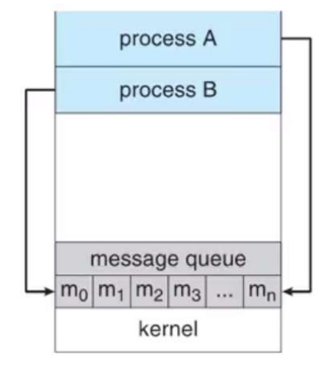
Communication Models
Message passing model:

Slide 14
Message passing cont’d
Mechanism for process to communicate and synchronize their actions
Message system process communicate with each other without resorting to shared variables
IPC facility provides two operations:
Send(destination, message)-message size fixed or variable
Receive(source, message)
If P and Q wish to communicate, they need to:
Establish a communication link between them
Exchange messages via send/receive
Implementation of communication link
Physical (e.g. shared memory , hardware bus)
Logical( e.g. direct or indirect, synchronous or asynchronous)

Slide 15
Cont’d
Implementation questions
How are links established?
Can a link be associated with more than two processes?
How many links can there be between every pair of communicating processes?
What is the capacity of a link?
Is the size of a message that the link can accommodate fixed or variable?
Is a link unidirectional or bi-directional?
There are two ways of link establishment
Direct communication
Indirect communication

Slide 16
Direct communication
Processes must name each other explicitly:
Send (P, message) –send a message to process P
Receive (Q, message) –receive a message from process Q
Properties of direct communication link
A link is associated with exactly one pair of communicating processes
Between each pair there exists exactly one link
The link may be unidirectional, but is usually bi-directional

Slide 17
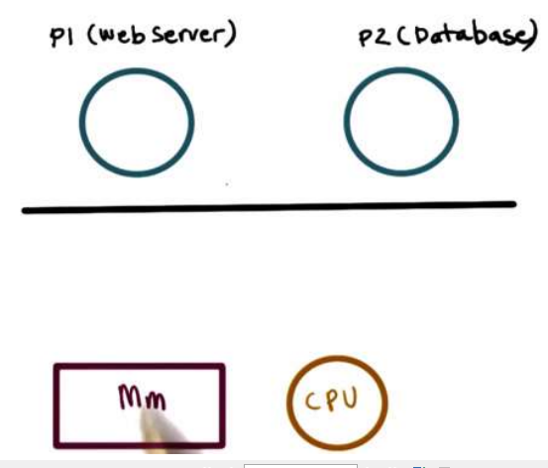
Indirect communication
Messages are directed and received mailboxes (also referred to as Ports).
Each mailbox has a unique id
Processes can communicate only if they share a mailbox
Properties of communication link
Link established only if processes share a common mailbox
A link may be associated with many processes
Each pair of processes may share several communication links
Link may be unidirectional or bi-directional

Slide 18
Cont’d
IPC Mechanisms
Transfer data/info between address spaces
Maintain protection and isolation
Provide flexibility and performance
Processes write(send) and read(receive)
Message passing vs shared memory
Advantage of message passing is that OS manages the channel.
Disadvantage is overheads and not fast as there is kernel interaction.
Advantage of shared memory is OS is out of the way after establishing the shared channel.
Disadvantage is synchronization problem.

Slide 19
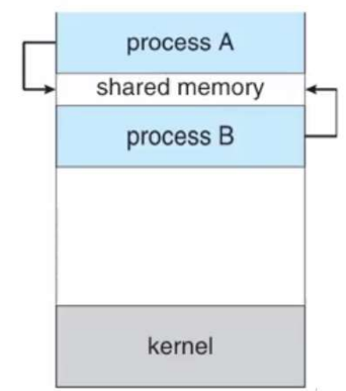
II. Shared memory
E.g., shmget(), shmat() in Unix
OS establishes shared channel and maps it into each process address space
Processes directly read/write from this memory
OS is out of the way

Slide 20
Race Conditions
In operating systems, processes that are working together share some common storage (main memory, file etc.) that each process can read and write.
When two or more processes are reading or writing some shared data and the final result depends on who runs precisely when, are called race conditions.
Concurrently executing threads that share data need to synchronize their operations and processing in order to avoid race condition on shared data.
Only one ‘customer’ thread at a time should be allowed to examine and update the shared variable.
Race conditions are also possible in Operating Systems.

Slide 21
Cont’d
If the ready queue is implemented as a linked list and if the ready queue is being manipulated during the handling of an interrupt, then interrupts must be disabled to prevent another interrupt before the first one completes.
If interrupts are not disabled then the linked list could become corrupt.
Critical Section
The key to preventing trouble involving shared storage is find some way to prohibit more than one process from reading and writing the shared data simultaneously.
That part of the program where the shared memory is accessed is called the Critical Section.
To avoid race conditions and flawed results, one must identify codes in Critical Sections in each thread.

Slide 22
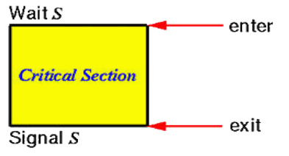
Cont’d
The characteristic properties of the code that form a Critical Section are:
Codes that reference one or more variables in a “read-update-write” fashion while any of those variables is possibly being altered by another thread.
Codes that alter one or more variables that are possibly being referenced in “read-update-write” fashion by another thread.
Codes use a data structure while any part of it is possibly being altered by another thread.
Codes alter any part of a data structure while it is possibly in use by another thread.
Here, the important point is that when one process is executing shared modifiable data in its critical section, no other process is to be allowed to execute in its critical section.
Thus, the execution of critical sections by the processes is mutually exclusive in time

Slide 23
Mutual exclusion
A way of making sure that if one process is using a shared modifiable data, the other processes will be excluded from doing the same thing.
Formally, while one process executes the shared variable, all other processes desiring to do so at the same time moment should be kept waiting; when that process has finished executing the shared variable, one of the processes waiting; while that process has finished executing the shared variable, one of the processes waiting to do so should be allowed to proceed.
In this fashion, each process executing the shared data (variables) excludes all others from doing so simultaneously. This is called Mutual Exclusion.
Note that mutual exclusion needs to be enforced only when processes access shared modifiable data - when processes are performing operations that do not conflict with one another they should be allowed to proceed concurrently.

Slide 24
IPC Methods
File – used to store resources for sharing
Signals-
used in UNIX operating system (occurs in process interruption)
Signal is a mechanism to communication between multiple processes by way of signaling. This means a source process will send a signal (recognized by number) and the destination process will handle it accordingly.

Slide 25
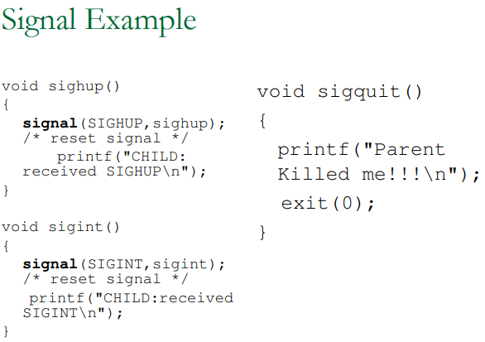
Cont’d

Slide 26
IPC Methods
Message queue –
Provides asynchronous or communication protocol (no need of sender and receiver to interact at the same time)
Communication between two or more processes with full duplex capacity.
The processes will communicate with each other by posting a message and retrieving it out of the queue. Once retrieved, the message is no longer available in the queue.
Queue of messages attached to the link
Zero capacity – 0 messages Sender must wait for receiver (rendezvous).
Bounded capacity – finite length of n messages Sender must wait if link full.
Unbounded capacity – infinite length Sender never waits.

Slide 27
Sockets-
Sockets provide point-to-point, two-way communication between two processes.
Sockets are very versatile and are a basic component of inter-process and intersystem communication.
Socket types define the communication properties visible to the application. Processes communicate only between sockets of the same type. There are five types of socket.
A stream socket provides two-way, sequenced, reliable, and unduplicated flow of data with no record boundaries. A stream operates much like a telephone conversation. The socket type is SOCK_STREAM, which, in the Internet domain, uses Transmission Control Protocol (TCP).

Slide 28
Cont’d
A datagram socket supports a two-way flow of messages. A on a datagram socket may receive messages in a different order from the sequence in which the messages were sent.
Datagram sockets operate much like passing letters back and forth in the mail.
The socket type is SOCK_DGRAM, which, in the Internet domain, uses User Datagram Protocol (UDP).
A sequential packet socket provides a two-way, sequenced, reliable, connection, for datagrams of a fixed maximum length.
The socket type is SOCK_SEQPACKET. No protocol for this type has been implemented for any protocol family.

Slide 29
Cont’d
Pipe
Access the O/P of each process (stdout) feeds directly as I/P (stdin)
Communication between two related processes.
The mechanism is half duplex meaning the first process communicates with the second process.
To achieve a full duplex i.e., for the second process to communicate with the first process another pipe is required.

Slide 30
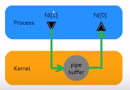
Pipes
Are used between parent and child
Always unidirectional
Accessed by two associated file descriptors
Fd[0] for reading from pipe
Fd[1] for writing to the pipe

Slide 31
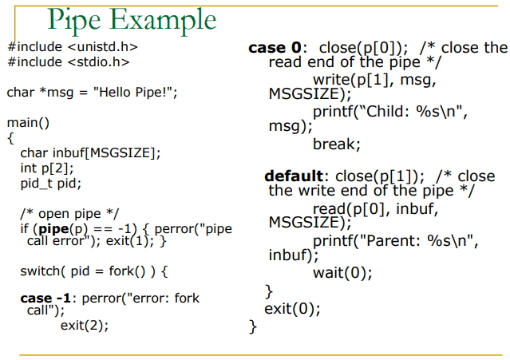
Cont’d

Slide 32
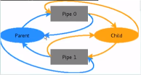
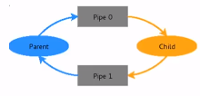
Pipes for two way communication
Two pipes opened pipe0 and pipe 1 . Close unnecessary pipes
Note the unnecessary pipes

Slide 33
THANK YOU!!
END

